Slide 1


Budget Report
Welcome to this year’s 1st
March 14th, 2023

Slide 2
Agenda
Fuller Creekside Glens Road Project
  Timeline
  Road Project Expense Breakdown
  Roads Fund Balances & 2024 Projections
  Certified Funds
  Payment Options
Balance Trends in Township Funds

Slide 3
Fuller Creekside Glens Road Project

Slide 4
Fuller Creekside Glens Road Project
Timeline
Date Description
Sep-22 Authorized Legislation
9/13/2022 Certified Funds for Local Share
12/15/2022 District 12 Integrating Committee approved funding (DIC)
1/13/2023 Project Slate sent to Ohio Public Works Commission (OPWC) for Review
7/1/2023 OPWC to Release Project Agreement
Jan -Mar 2024 Plans to be received from Engineer's Office
Jan -Mar 2024 Resolution to approve plans & advertise the project
Jan -Mar 2024 Project Bidding
Jan -Mar 2024 Encumbrance of Money
Apr-24 Start to Pay Contractor at Beginning of the Project
May-25 Anticipated Completion Date

Slide 5
Fuller Creekside Glens Project 2024-2025
Expense Breakdown
$556,700 Construction Total
$ 47,800 Design/Inspections/Asphalt Testing/Bidding Total
$604,500 Total Project Cost
Payment Breakdown
$299,832 Grant Funding Approved through (DIC) District 12 Integrating Committee
$304,668 Remainder Due for Project (Certified Local Share):
$21,672 County Share
$282,996 Township Share
Information from Ohio Township Association (OTA)/ per ODOT: In last 4 years, asphalt pricing increased by 29%
and pavement repair increased by 46%.

Slide 6
ROADS Fund Balances and Projections
Budget Projection:
Fund | Jan 2023 Beginning Balance | 2023 Estimated Revenue | 2023 Estimated Expenses | Jan 2024 Estimated Balance
2011 MVLT | $19,219 | $4,735 | $4,000 | $19,954
2021 Gas Tax | $152,328 | $124,150 | $124,050 | $152,428
2031 Roads | $136,924 | $69,197 | $69,107 | $137,014
2231 Permissive | $22,807 | $8,650 | $8,650 | $22,807
2273 ARP Grant | $21,374 | $0 | $0 | $21,374
Total | $352,652 | $206,732 | $205,807 | $353,577

Slide 7
Fuller Creekside Glens Roads Project Certified Money in the Following Funds:
Fund |  | Original (May Vary) | Variation
2011 | MVLT | $5,000 | $15,000
2021 | Gas Tax | $175,000 | $106,622
2031 | Roads | $100,000 | $125,000
2231 | Permissive | $5,000 | $15,000
2273 | ARP Grant | $20,000 | $21,374
Total |  | $305,000 | $282,996
County Share |  |  | $21,672
Certified Amount |  |  | $304,668
Township does not have authority to transfer money from these funds. Must pay from these funds directly.

Slide 8
Fuller Creekside Glens Road Project
Payment Options
1) Pay Certified Amount from Road/Grant Funds
2) Loan Option (Bond Cost Average: $10,000)
-Contact Law Firm to draft Resolution/Documents (October 2023)
in order to obtain Municipal Bond from a Certified Bond Counselor
*Squire Patton Boggs, Ph: 216-479-8389 Fax: 216-479-8780
*Recommended by Huntington Bank and John Borell.
-Obtain Set Interest Rate from Bank
-Pass Resolution & Obtain Bond to Finance.

Slide 9
Fuller Creekside Glens Road Project
Payment/Loan Information
Grant Application Scored with Local Share.
Grant Received in Amount of: $299,832
N/A for OPWC Loan.
Limited Tax General Obligation (LTGO) Bonds issued within Township 10 mil limit have no tax increase, therefore no voter approval is required.
LTGO is within taxing authority and is a property tax pledge with no collateral.
Unlimited, voters must approve.

Slide 10


Borrow Versus Invest
-Interest Rates-
Borrow 4.75%-6%
Invest 3.42% (Current)
This Photo by Unknown Author is licensed under CC BY-NC

Slide 12
Fuller Creekside Glens Project
Payment Option 2: Loan
Financing Rates:
Bond Cost: $8,000 to $12,000
Remainder Due
for Project: $304,668
Current
Bank Interest Rates: 4.75% to 6%
Length of Loan: 5 to 15 yr.

Slide 13
Fuller Creekside Glens Road Project Payment Option 2-Loan Breakout by Fund **Interest not Included** County Share & Grant Money =$43,046 0% OPWC Loan N/A
Certified in the following Funds: |  | Original Certification (May Vary) | Variation | 1st Payment | **5 YR** (Pay Each Yr) | **10 YR** (Pay Each Yr) | **15 YR** (Pay Each Yr)
2011 MVLT |  | $5,000 | $15,000 |  | $3,000 | $1,500 | $1,000
2021 Gas Tax/ County Share $21,672 |  | $175,000 | $128,294 |  | $25,659 | $12,829 | $8,553
2031 Roads |  | $100,000 | $125,000 |  | $25,000 | $12,500 | $8,333
2231 Permissive |  | $5,000 | $15,000 |  | $3,000 | $1,500 | $1,000
2273 ARP Grant |  | $20,000 | $21,374 | $21,374 | $0 | $0 | $0
Total |  | $305,000 | $304,668 | $21,374 | $56,659 | $28,329 | $18,886
Please Note: Township share: $282,996 County Share to receipt into Gas Tax Fund & to be paid out of out Gas Tax Fund.

Slide 14
Resources: Municipal Bonds (Loans)/Resolution/Ordinance/Documents Certified Bond Counselors: *Squire Patton Boggs, Ph: 216-479-8389 Fax: 216-479-8780 *Recommended by Huntington Bank and John Borell. Frost Brown Todd Dinsmore & Shohl Auditor of State's Project Manager: Kyle McConnell ph: 800-345-2519 Fax: 866-241-1074 email: KjMcConnell@ohioauditor.gov Bulletin 2002-004 May 28, 2002 Capital Projects Fund 4401-4499

Slide 15
Resources (continued): Ohio Township Association (OTA)/per ODOT: In last 4 years, asphalt pricing increased by 29% and pavement repair increased by 46%.

Slide 16
Balance Trends
in Township Funds

Slide 18
Most change in Roads & Fire Funds
FIRE
$398,514
Total
ROADS
$103,255
Roads

Slide 19
2020
Receipted in BWC Dividends $273,029
2021
Transferred $100,000 to Fire
for Ambulance
YEAR

Slide 20


ROAD FUNDS

Slide 21


2191 FUND
Tow Lot Originated in 2016
Gross Revenue Received from Tow Lot:
$830,898
Net Revenue in:
2022: $157,918
2021: $119,204
POLICE FUNDS
POLICE FUNDS

Slide 22


2021
Receipted in $100,000 from General for Ambulance

Slide 23
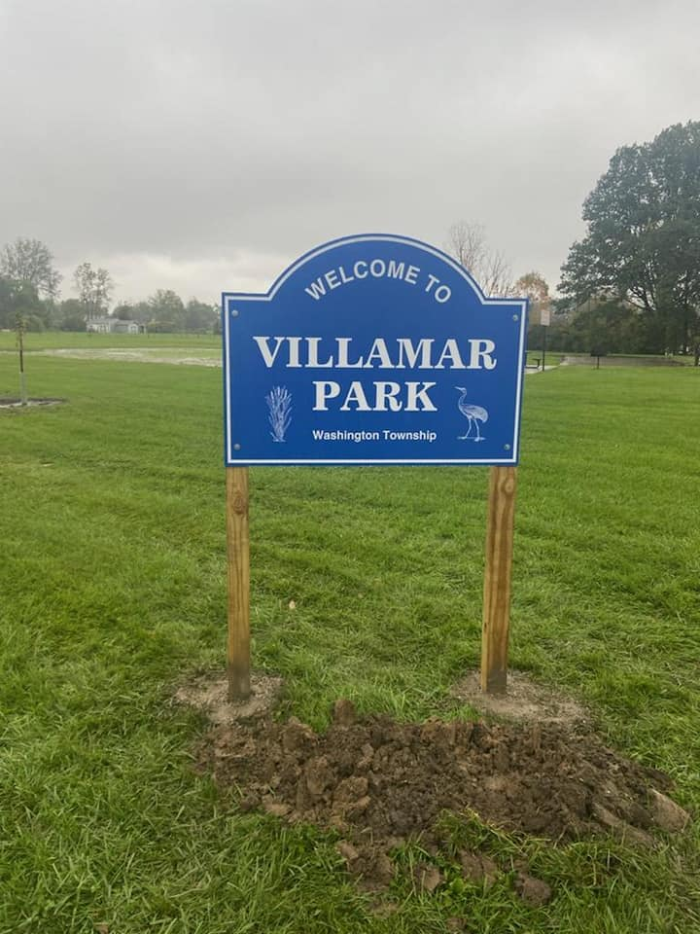
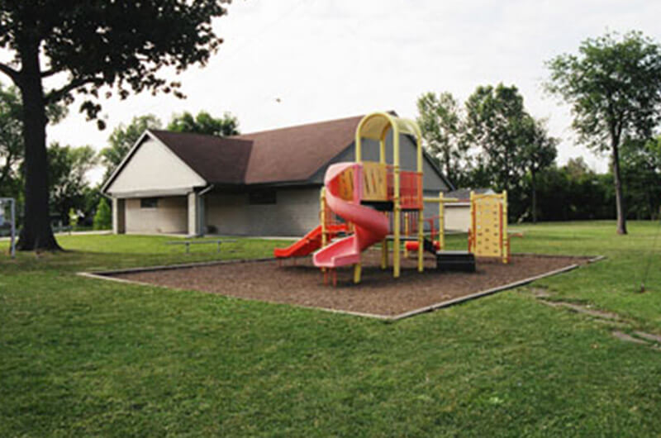

2020-2021
LOW REVENUE IN SHELTER RENTALS DUE TO COVID
YEAR

Slide 24


Slide 25

ON TRACK IS WHERE WE STAND
YTD Profit Per Dept.
Roads: $40,835
Park: $12,663
Police: $89,906
Fire: $68,203
General: $17,172
17%---------------------------------------------------------------------------------------

Slide 26
Thank you for attending.
If you have any questions please email:
fiscal-officer@washington-twp.com

